Slide 1
SAGAR KALAUNI
2024 Analytics & Insight-Intern

Slide 2


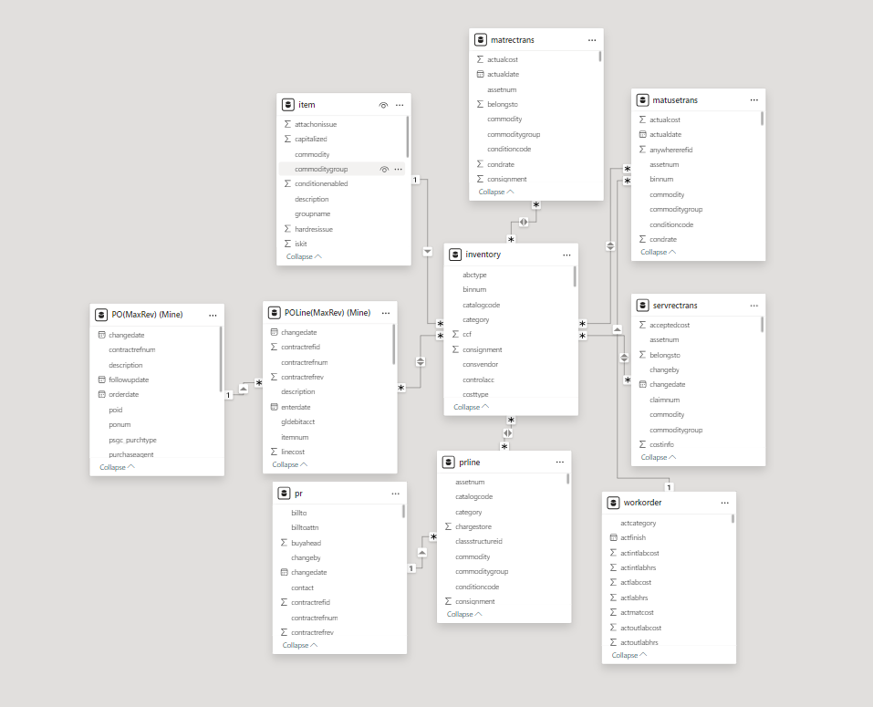



Updated Dashboards
Modified and Updated dashboard only!
Updated Dashboard Only
Update

Slide 3

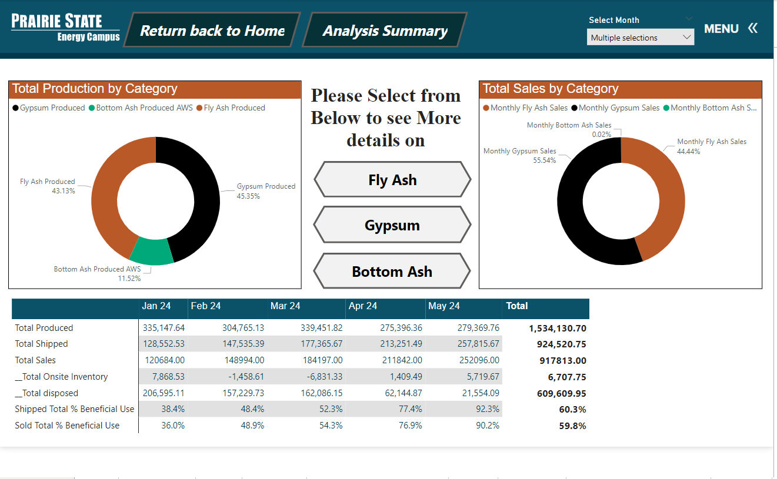
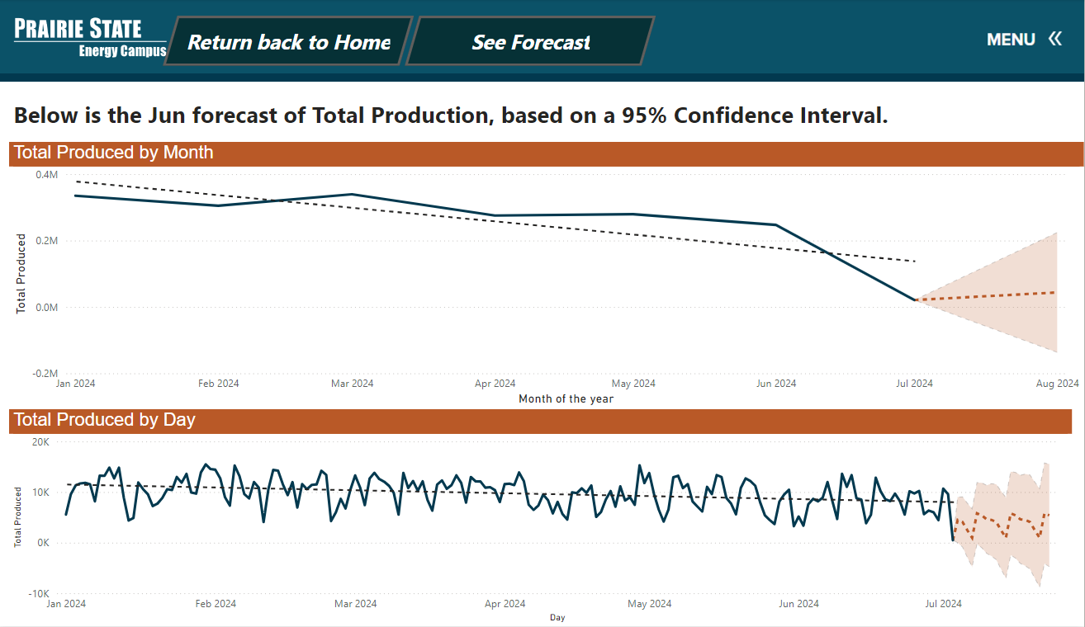
Plant By product Analysis
Dashboard was already Created with all calculation.
Make it look more Aesthetics and more dynamic
Added few Prediction Lines
PAGE 01

Slide 4
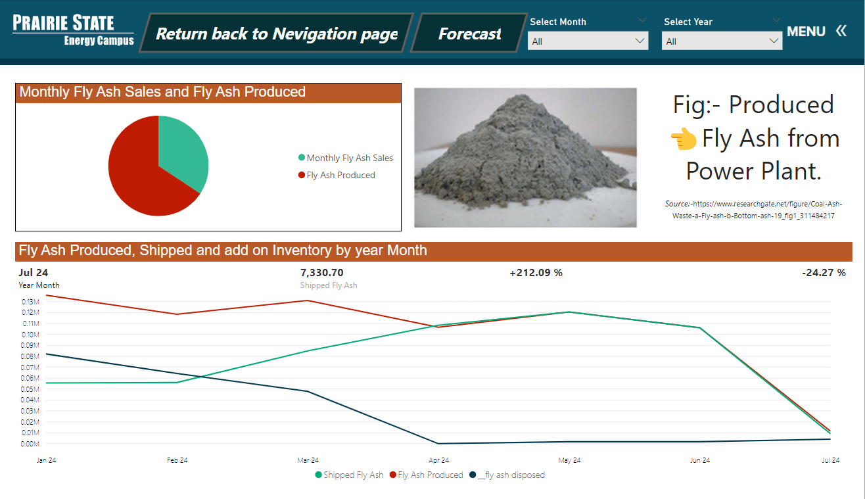
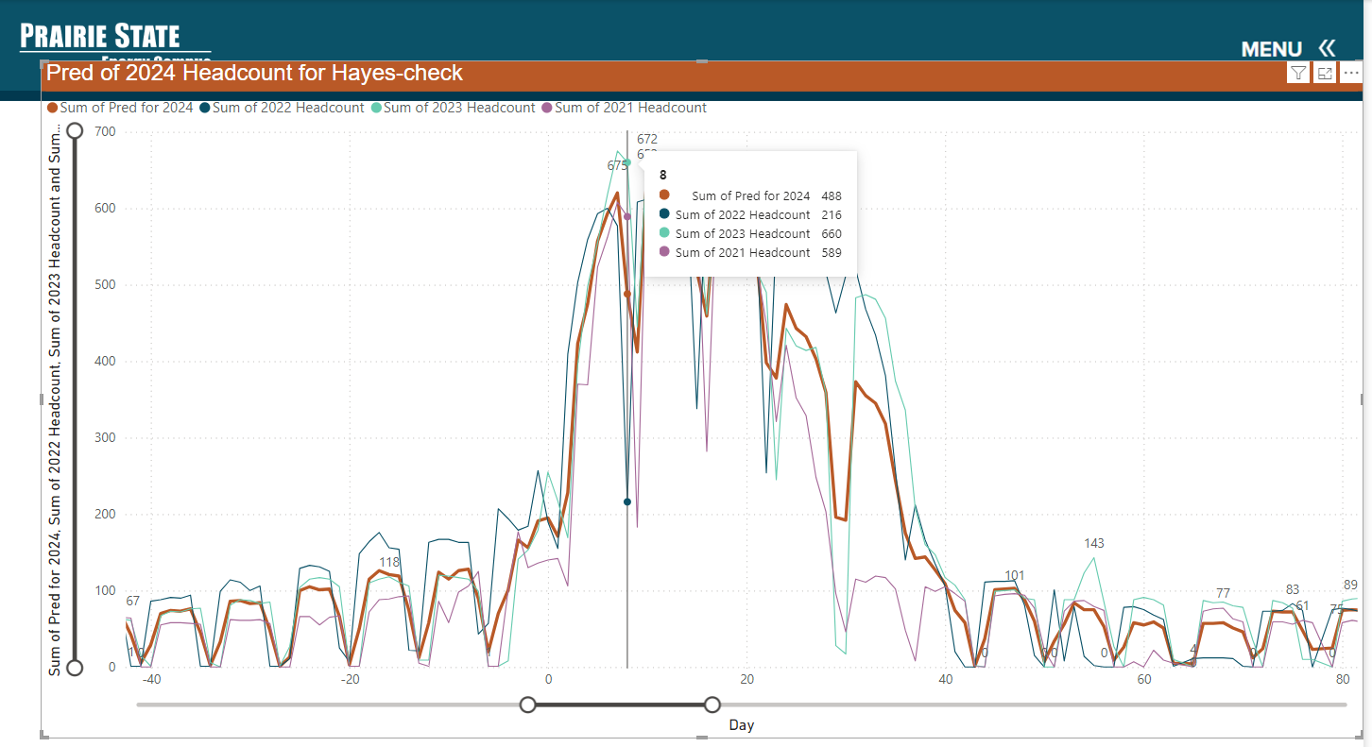
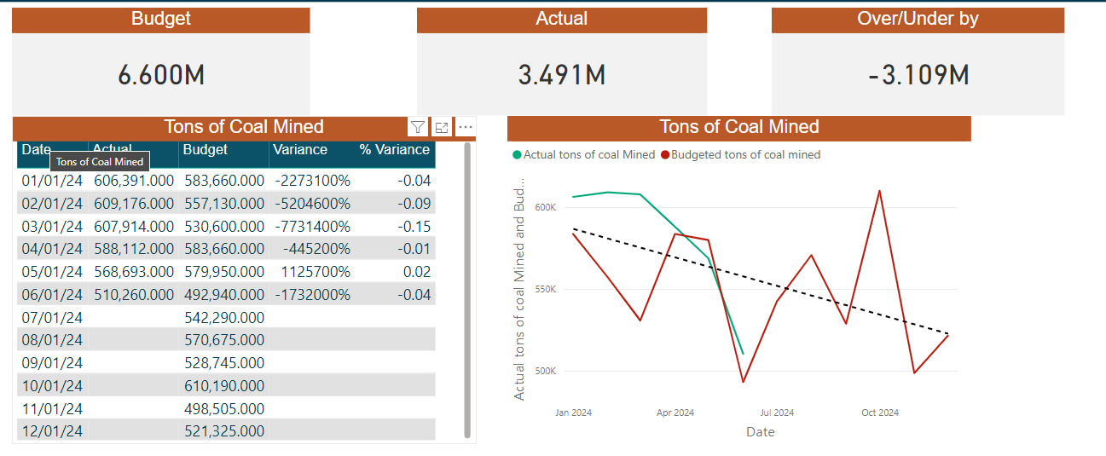
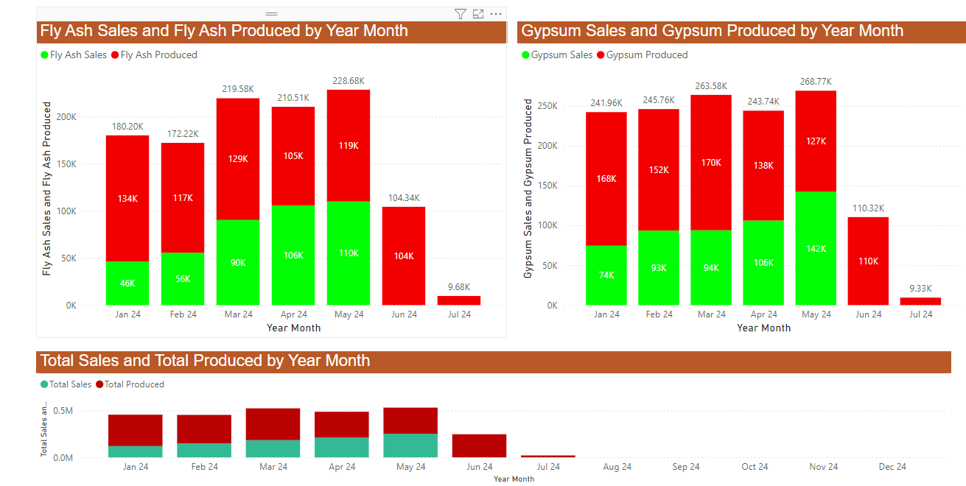
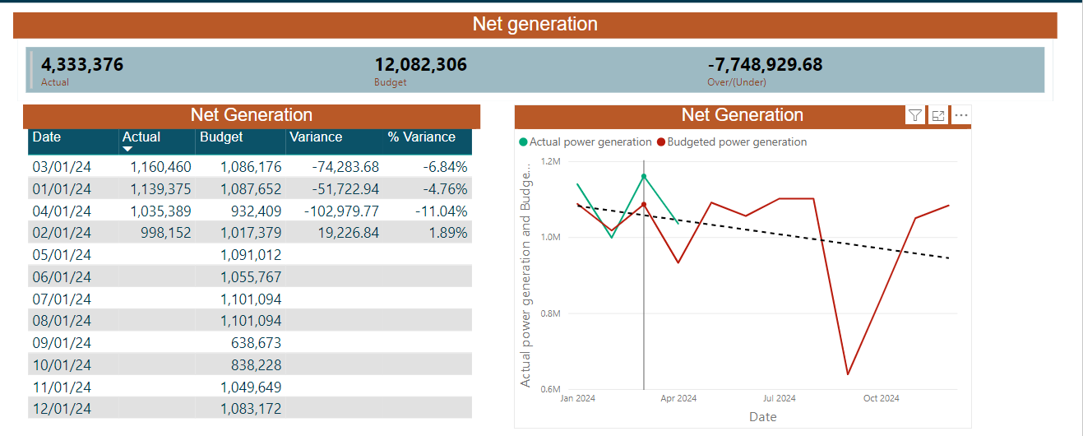
Details by Type
Headcount and Budget Analysis
Made a separate Tab for each byproduct, with their
Detailed Analysis of Production, Ship and Sales.
Added Prediction line of 2024 head count
Looked at budget Vs Actual Report
PAGE 02
PAGE 03

Slide 6



Special Thanks To:
Josh Hagene, Mackenzie Tabing, Jonathan Sander, Jeff Miller, Tom Foust Jr
Tyler Tiemann, Claire Beyes, Alyssa Lohmann
David Sohn, Dustin Wathen, Justin Gale, Melissa Weber
Randy Short and whole PSGC team.

